Slide 1

CLOUD BASED TRACKING SYSTEM
MUHAMMAD FAIZ IZZUDDIN BIN IZHAR 01DIS17F1093
MUHAMMAD HAZIQ BIN ZULKURNAIN 01DDT18F1186

Slide 2
Tech Requirements
Network
Satellite
Link

Slide 3

Cloud computing
Cloud
Local

Slide 4
1.0 INTRODUCTION
An alternative method of checking in to campus and classes without the use of RFID & Barcode
A method which the students does not require/afford a constant internet connection
A method where using the practice of new norm while maintaining the guidelines of Social Distancing
Using the cloud computing, the system offer a smooth and fluid checking in without student being congested/queue causing social traffic

Slide 5
2.0 PROBLEM STATEMENT
The current method uses the centralized method
Every students are required to have working smartphones and constant internet connection
Dependent on a single way to checking in which is via “MySejahtera App”
Should it fail, we have to manually write down on paper with a pen
APDV 4
SEMINAR ROOM
CNW3

Slide 6
3.0 Objective of project
Develop a cloud based system that offers an alternative solution via RFID and Barcode for checking in
Create a system that ables to log in-depth/highlights routes travels by the students ( From one class to another)
An offline method whereby the students does not requires constant internet

Slide 7
4.0 SCOPE OF PROJECT
User
Every student of Polytechnic Ungku Omar
System
Verification of a students with the usage of existing barcode and RFID
Allow lectures to interact with the system to see the students log
Display the route of students have taken

Slide 8
5.0 Project significance
Student should not be worried that if their smartphones are unable to uses the apps
Not every student could afford the constant Internet Data
Student studies should not be hindered because the are unable to comply the mandatory checking in via MySejahtera
Polytechnic Ungku Omar is prepared with a redundant solution that which current app failed

Slide 9
6.0 Literature review
“MySejahtera App”
Used as a baseline/foundation for benchmark
Student Card
A unique identification card that is one major component of the project
RFID Reader
Primary tool that verifies they authentication of the student
Barcode Reader
A redundant tool which goal is to provide secondary redundant option

Slide 10
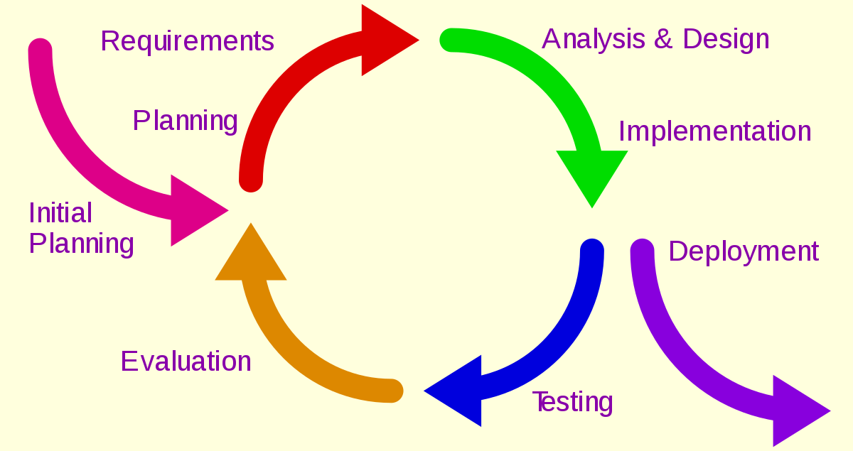
7.0 Methodology (incremental & interactive)

Slide 11
7.0 cont..
Initial Planning
Requirements Planning
Analysis & Design
Implementation
Testing
Evaluation
Deployment

Slide 12
9.0 gantt chart
WEEK/ PLANNING | 1 | 2 | 3 | 4 | 5 | 6 | 7 | 8 | 9 | 10 | 11 | 12 | 13 | 14 | 15
Initial Planning Planning the project and title Finding Supervisor Student Registration Form
Requirement Planning Proposal Discussion Prepare Project Proposal Present and Submit Proposal Information gathering
Analysis and Design Analysis the information Start with the build of the hardware Manage the software
Implementations Test it on a location
Testing Test on a real situation Record the test
Evaluation Upgrade and evolve it
Deployment 7.1 Deploy it on market

Slide 13
10.0 IMPLEMENTATION COST
No | Item | Price
2 | Arduino Board x2 | RM 25.8
3 | Bread board x2 | RM 3.00
4 | Jumper Cable x2 | RM 2.40
5 | RFID Sensor & Card x2 | RM 11.50
6 | LED x2 | RM 1.00
7 | RFID Sticker x2 | RM 13.00
8 | Total x2 | RM 93.40

Slide 14

Thank You

